Slide 1

^{Chapter 1} Introducing Data Structures and Algorithms
Royal University of Phnom Penh
Faculty of Engineering
Data Structures and Algorithms
Dr. Srun Sovila

Slide 2
Outline
Arrays
Ordered Arrays
The Bubble Sort
The Insertion Sort

Slide 3
Outline
Arrays
Ordered Arrays
The Bubble Sort
The Insertion Sort

Slide 4


Bubble Sort¹
For what sorting?
Arrange names in alphabetical order, students by grade, customers by zip code,…
Sorting data is a preliminary step to search; E.g. applied Binary search to sorted data, is much faster then linear search
For example of Unordered and Order data
The Unordered (by Height) Baseball Team
The Ordered (by Height) Baseball Team

Slide 5
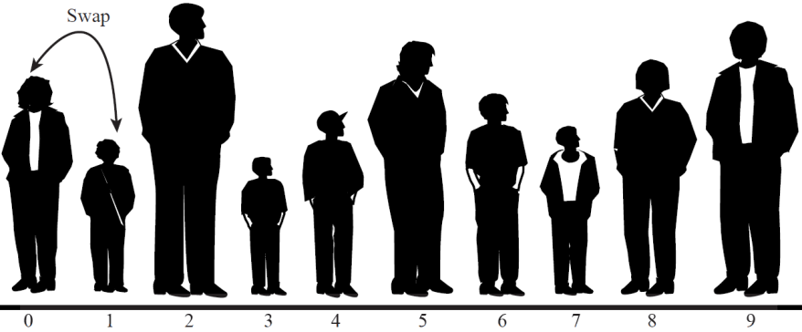

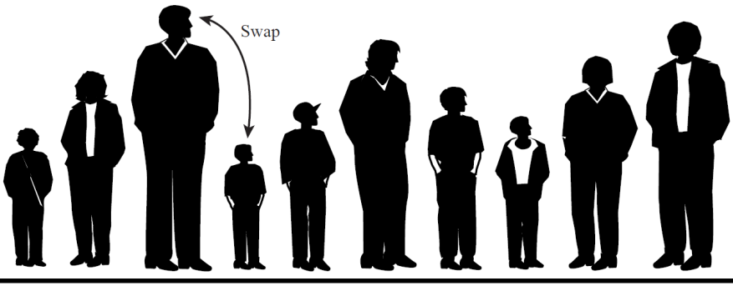

Bubble Sort: How Does It Work?
Start from left end of line, and compare the two players in position 0 and 1;
If the player on the left (in position 0) is taller, swap them. Otherwise, do nothing;
Then, move over one position and compare the players in positions 1 and 2. Again, if the player left is taller, swap them.

Slide 6

Bubble Sort: End of First Pass
The tallest player will be swapped every time, compare two kids, until eventually he (or she) will reach the right end of the line
After this first pass, it was (n-1) comparisons (where n – number of players), and somewhere 0 and (n-1) swaps
The item at the end of the array is sorted and won’t be moved again
Then, go back to the left end of the line, compare player 0 and 1 again, and so on to the right. At this time (second pass), will stop at position (n-2), because the last position (n-1) is the tallest. Continue this process until all the players are in order.
End of First Pass

Slide 7
Bubble Sort: Code in C/C++
for( i=0; i<nElems-1; i++ ){ //number of sorted elements or i^{th} pass for( j=0; j<nElems-i-1; j++ ){ //circle to take the tallest to the right end if( arr[j] > arr[j+1] ){ //if the left is taller? tmp = arr[ j ]; /*swap arr[ j ] and arr[ j+1 ] */ arr[j] = arr[ j+1 ]; arr[ j+1 ] = arr[ j ]; tmp; } //End if } //End j loop } //End i loop
Please try with Bubble sort animation, here:
http://cathyatseneca.github.io/DSAnim/web/bubble.html

Slide 8
Bubble Sort: Efficiency
If n – number of items in the array
So for the 1st pass there are (n-1) comparisons, 2nd pass there are (n-2) comparisons, and so on.
Thus, total of comparisons is:
(n-1) + (n-2) + (n-3) + … + 1 = n*(n-1)/2
Because constants do NOT count in Big-O notation, we can say that the bubble sort runs in O(n²) time.

Slide 9


Homework submit to: fe.assignment@gmail.com
Mon., 26-Oct.-2015
@ 15:00
Write a function, which will sort data of array by ascending or descending with Bubble sort algorithm (Option ascending or descending will be input by user);
Explain your codes by comments;
Draw flow chart of your source codes.

Slide 17
To be continued…

